Slide 1
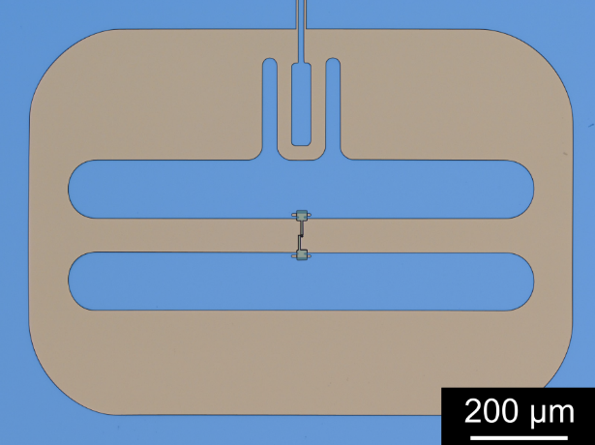
Krylov solver

Slide 2
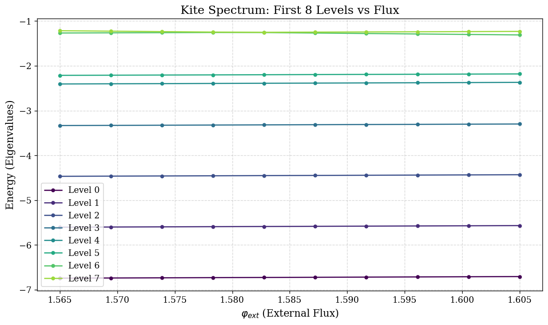
Shift invert, Why ?
Current algorithm : Lanczos Solver

Slide 3

Shift invert, Why ?
Current algorithm : Krylov Solver
2 issues :
Climbing the whole spectrum
To have n-th state : compute $⟦0,n−1⟧$
n is big for readout

Slide 4
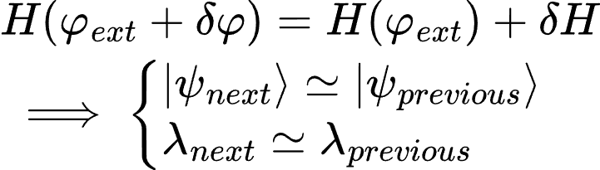
Shift invert, Why ?
Current algorithm : Krylov Solver
2 issues :
Climbing the whole spectrum
To have n-th state : compute $⟦0,n−1⟧$
n is big for readout
Discarding previous information
Independant
computations

Slide 5
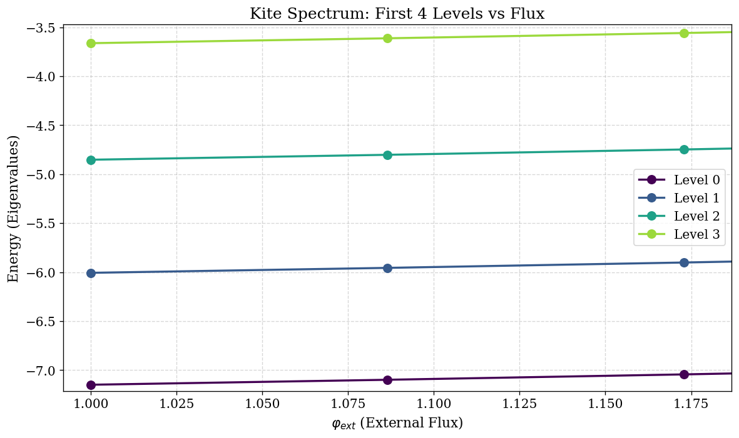
The idea
Aimed energy level (one state)
Starting point
Computing iteratively the next value
With previous result

Slide 6
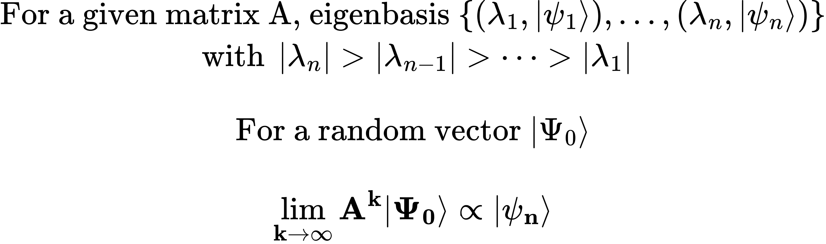
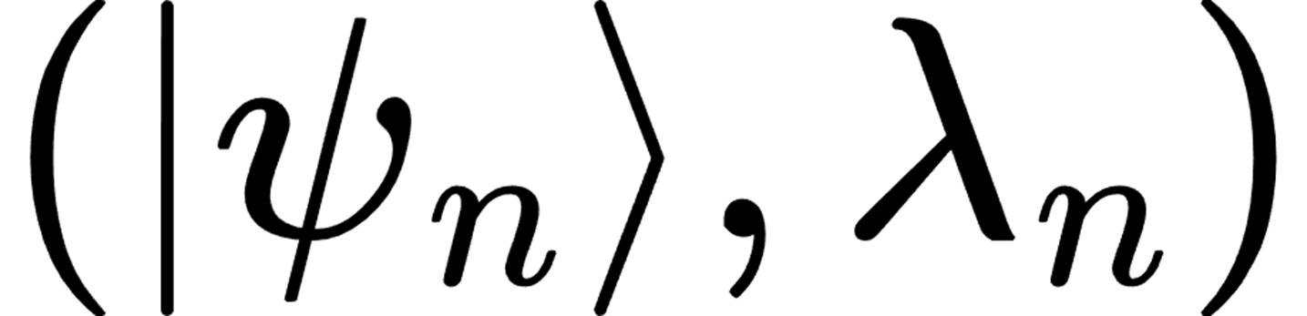
The power algorithm
Power algorithm
Matrix

Slide 7



















Shift Invert
$$E_{n+1}$$
$$E_{n+1}−E$$
$$\frac{1}{δE}$$
$$E_{n}$$
$$0$$
$$E_{n}−E$$
Energy
$$H$$
$$E_{n−1}$$
Energy
$$H−E Id$$
$$E_{n−1}−E$$
Energy
$${\left(H−E Id\right)}^{−1}$$
…
…
$$E_{1}$$
$$E_{1}−E$$
$$E_{0}$$
$$E_{0}−E$$
$$\frac{1}{E_{i}−E}$$
$$0$$
$−E$
$$0$$

Slide 8
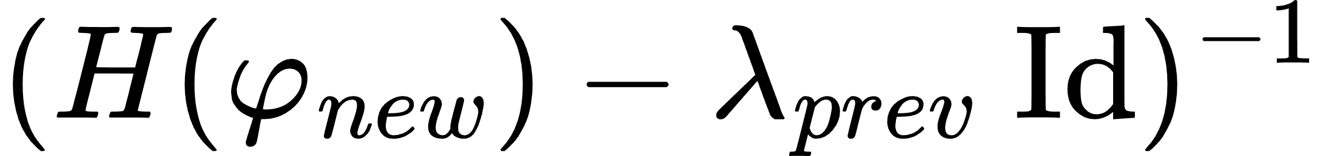



Shift Invert
$$E_{n+1}$$
$$E_{n+1}−E$$
$$\frac{1}{δE}$$
$$E_{n}$$
$$0$$
$$E_{n}−E$$
Energy
$$H$$
$$E_{n−1}$$
Energy
$$H−E Id$$
$$E_{n−1}−E$$
Energy
$${\left(H−E Id\right)}^{−1}$$
…
…
$$E_{1}$$
$$E_{1}−E$$
$$E_{0}$$
$$E_{0}−E$$
$$\frac{1}{E_{i}−E}$$
$$0$$
$−E$
$$0$$
Power algorithm
Minres to find

Slide 9
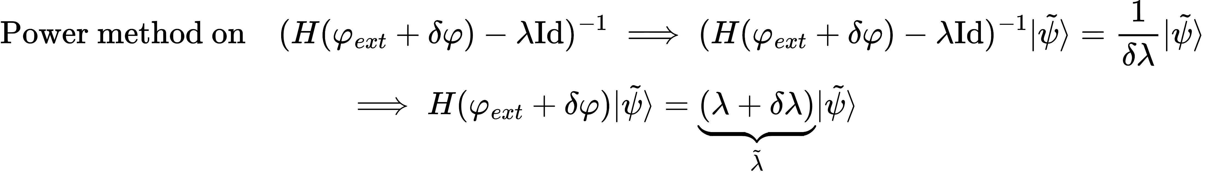
How to check the accuracy ?
Not computable
Reference ?

Slide 10
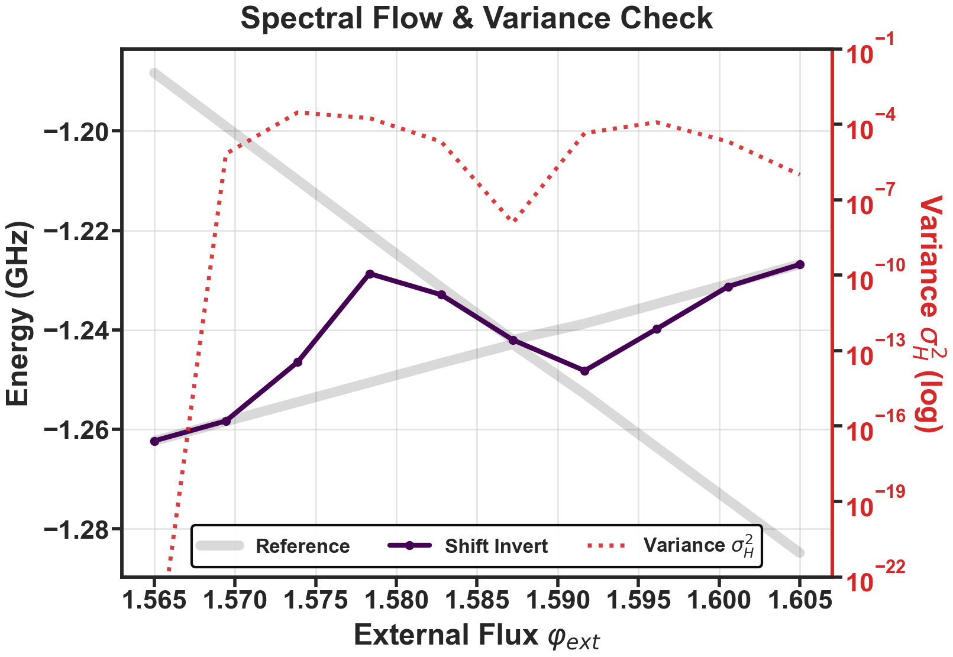
How to check the accuracy ?
Not computable
Reference ?
Check convergence toward eigenvalue : Variance

Slide 11
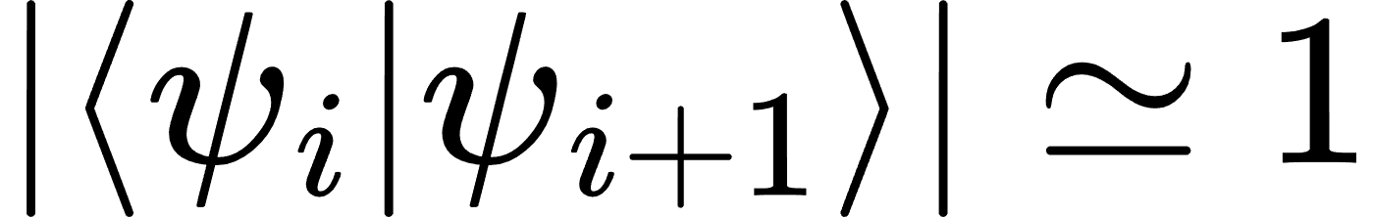
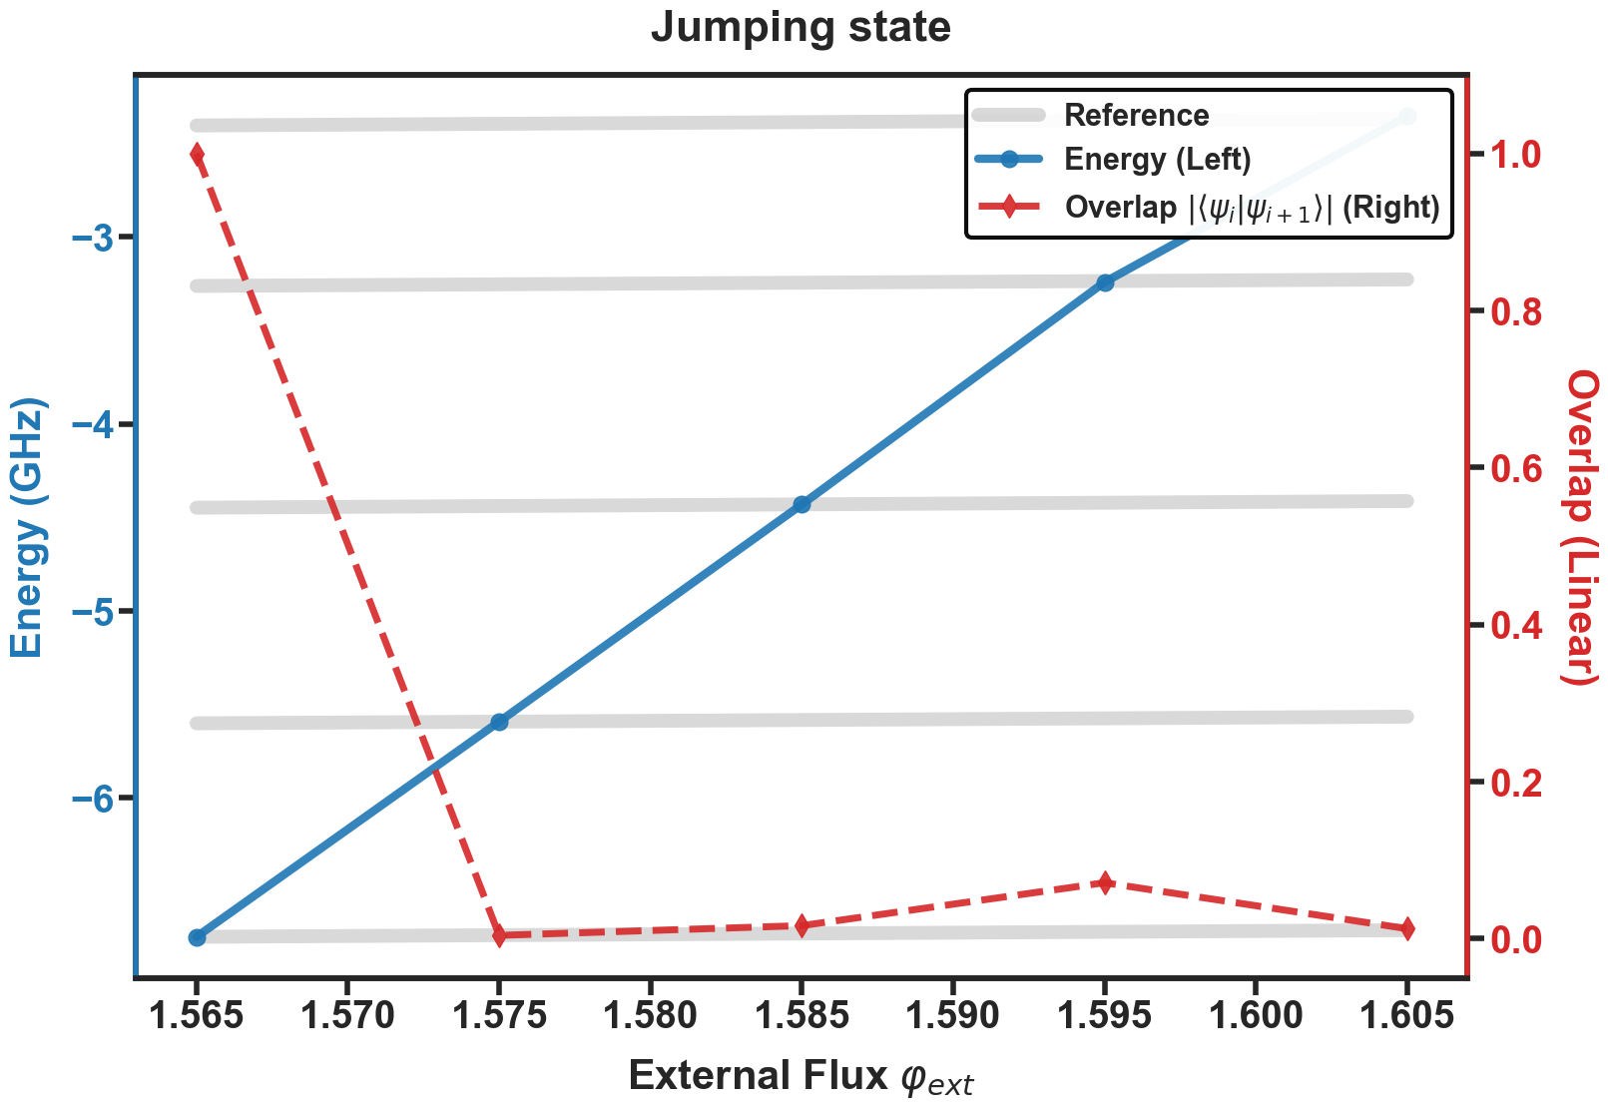
How to check the accuracy ?
Not computable
Reference ?
Check convergence toward eigenvalue : Variance
Check if didn’t jump : Overlap

Slide 12
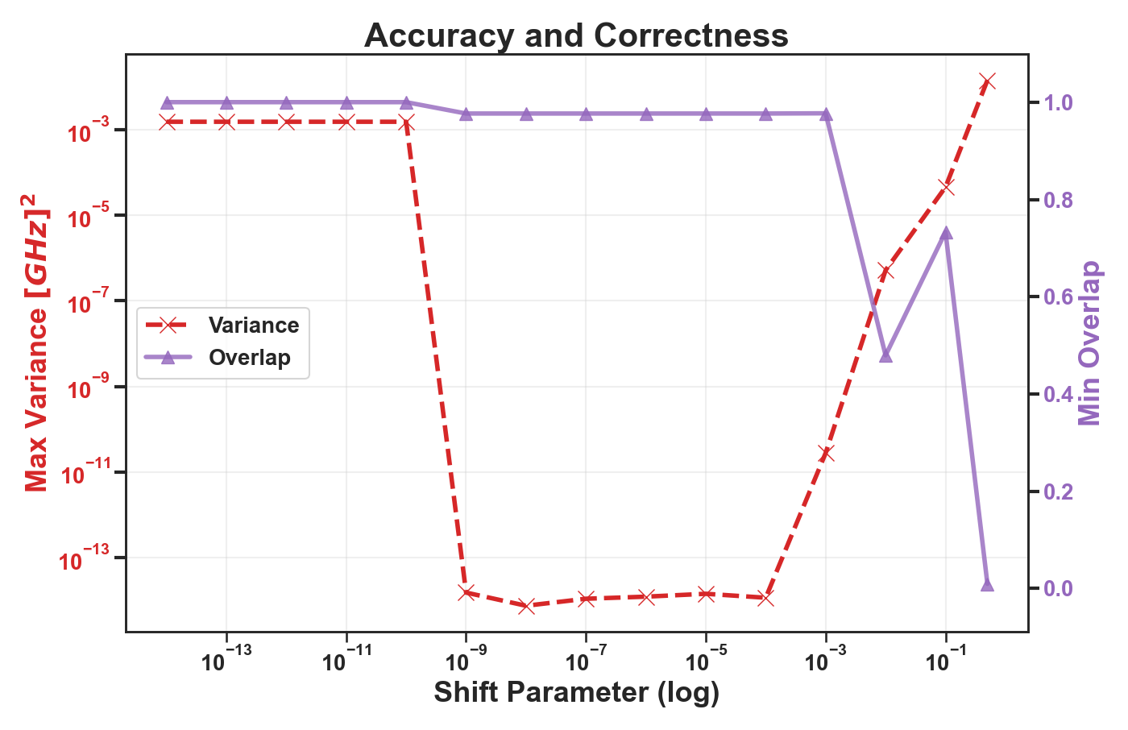
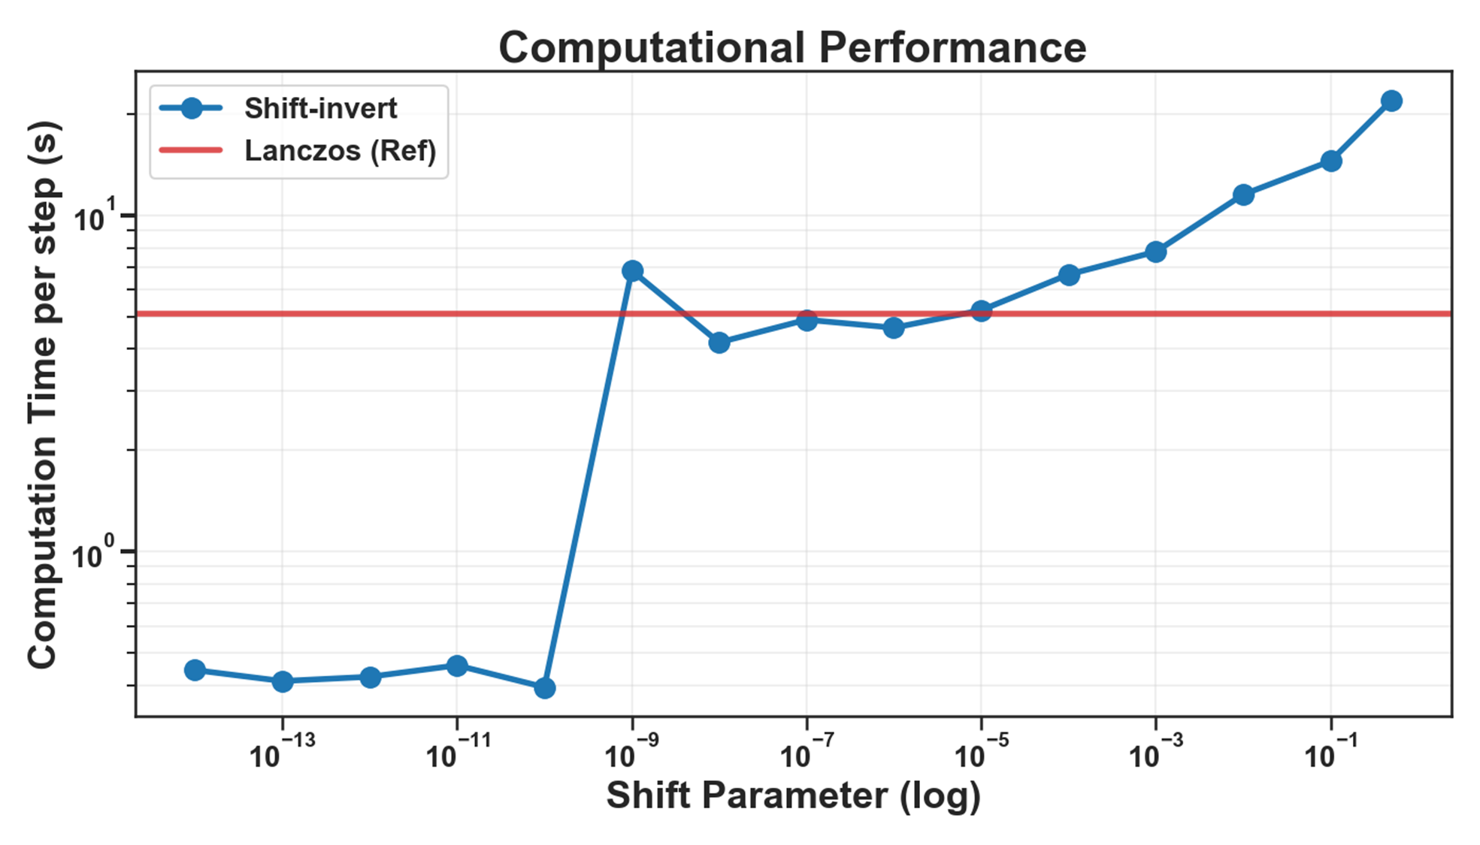



The shift parameter
Energy
$${ \left(H−E Id\right)}^{−1}$$
$$\frac{1}{shift}$$
$$0$$

Slide 13
The shift parameter
Energy
$${ \left(H−E Id\right)}^{−1}$$
$$\frac{1}{shift}$$
$$0$$
Numerical error

Slide 14
The shift parameter
Energy
$${ \left(H−E Id\right)}^{−1}$$
$$\frac{1}{shift}$$
$$0$$
Numerical error
Sweet
spot

Slide 15

The shift parameter
Energy
$${ \left(H−E Id\right)}^{−1}$$
$$\frac{1}{shift}$$
$$0$$
Numerical error
Sweet
spot
$$shift≃ΔE$$

Slide 16
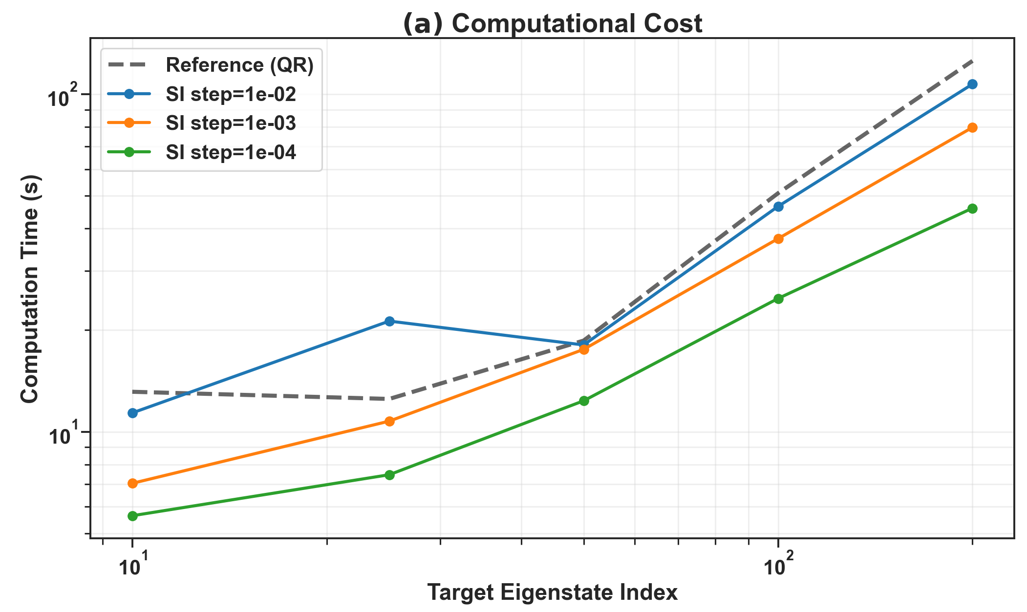
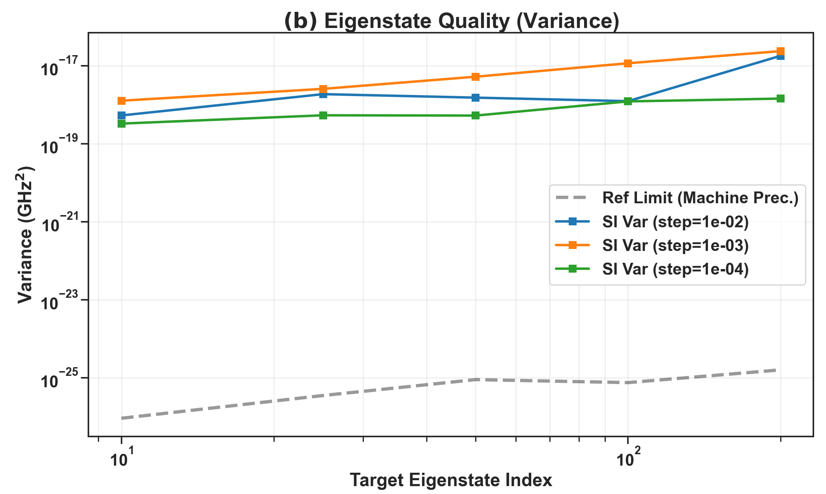
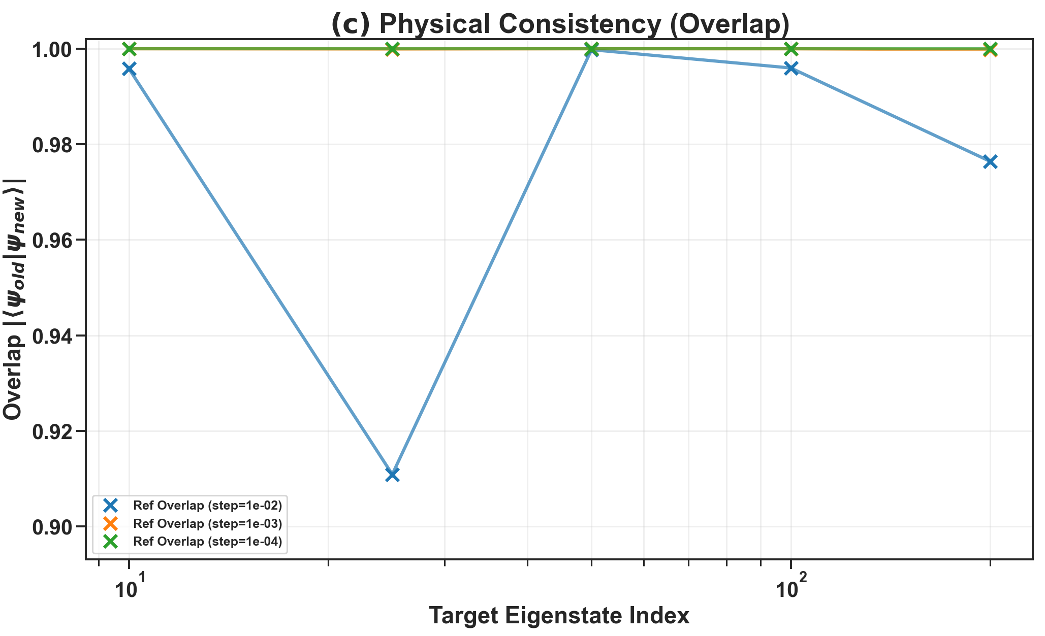
Shift invert versus Lanczos, dim 28125

Slide 17
Annexe

Slide 18
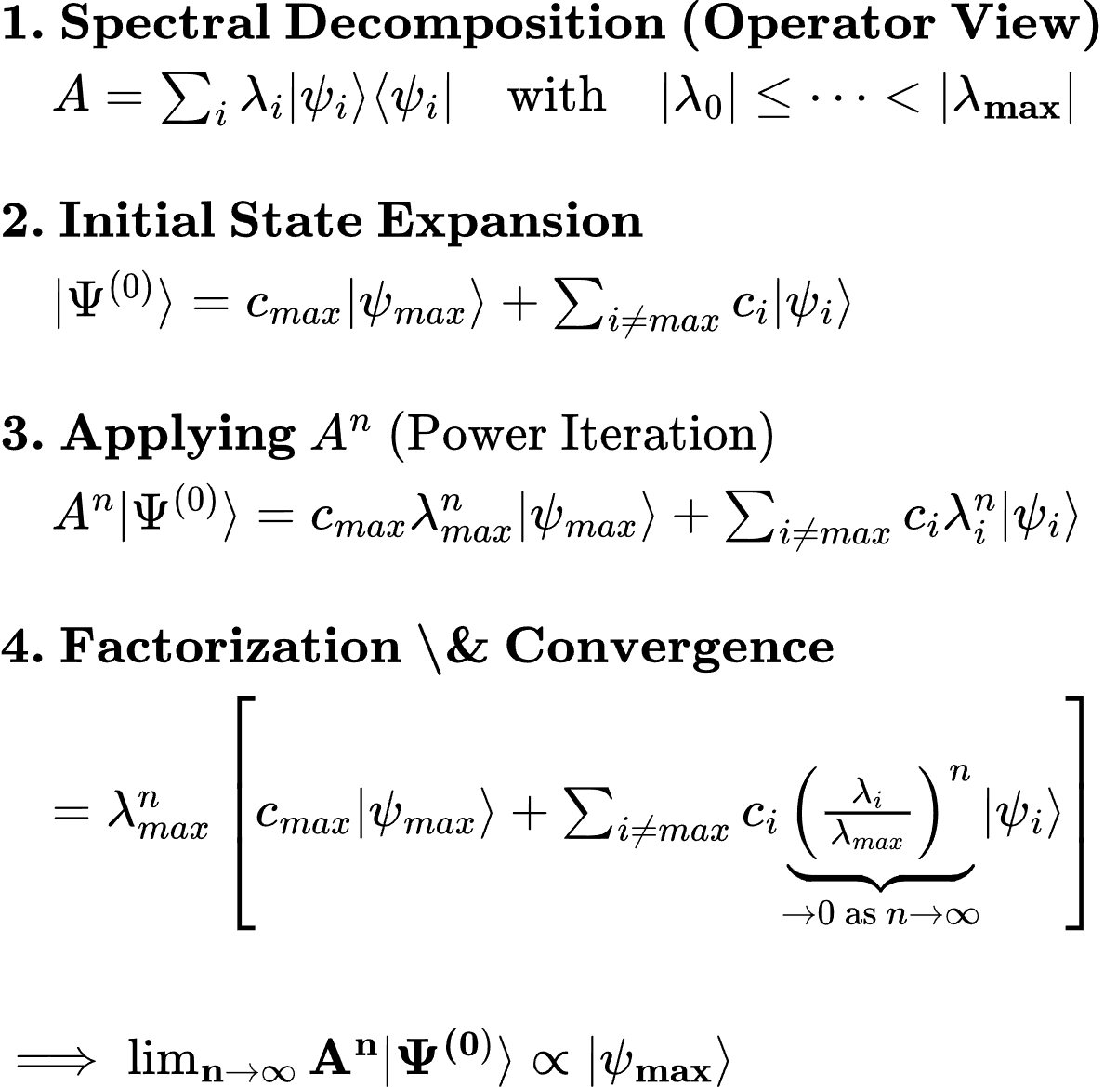
The power algorithm : Find the dominant eigenspace

Slide 19
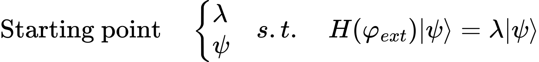
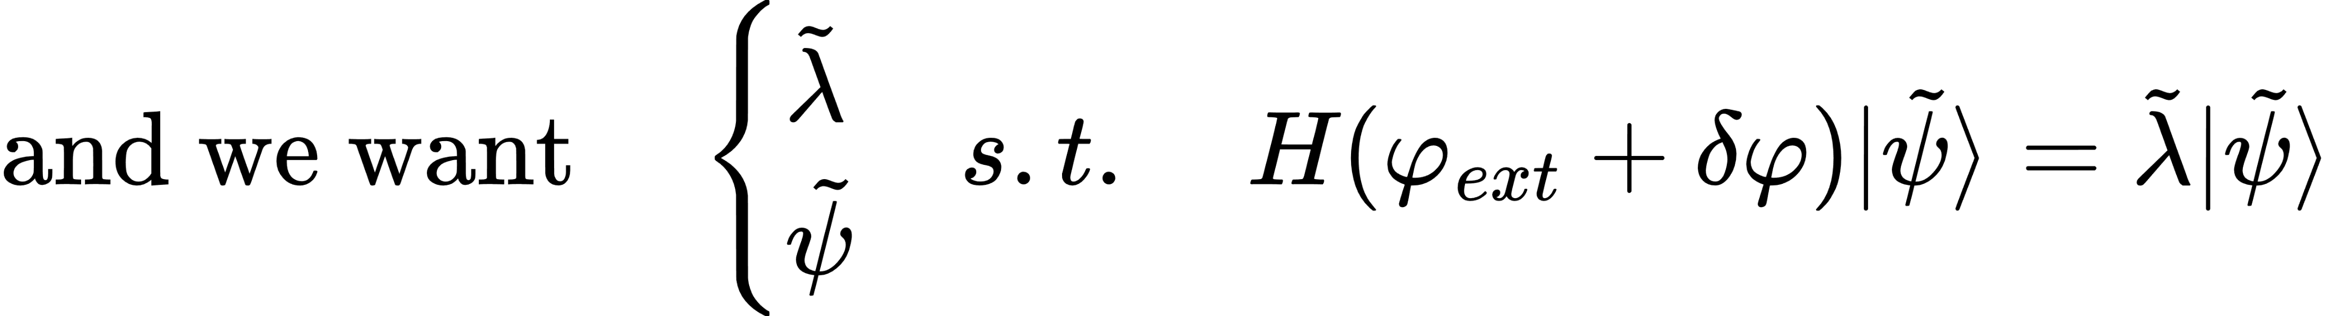
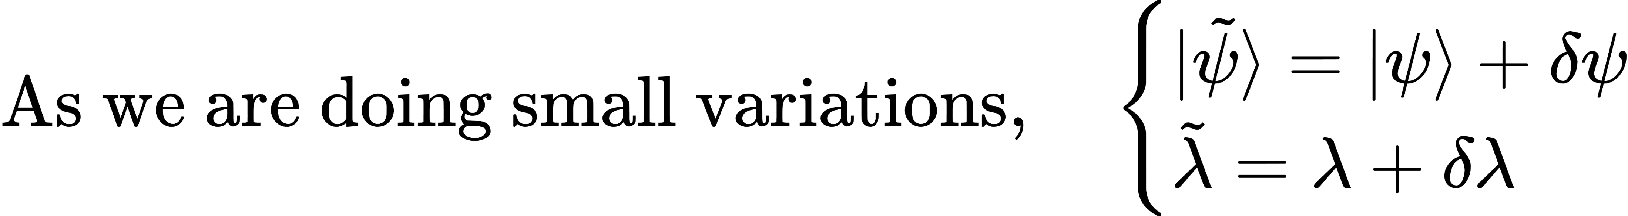
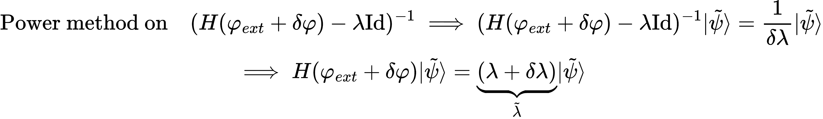
Shift Invert

Slide 20
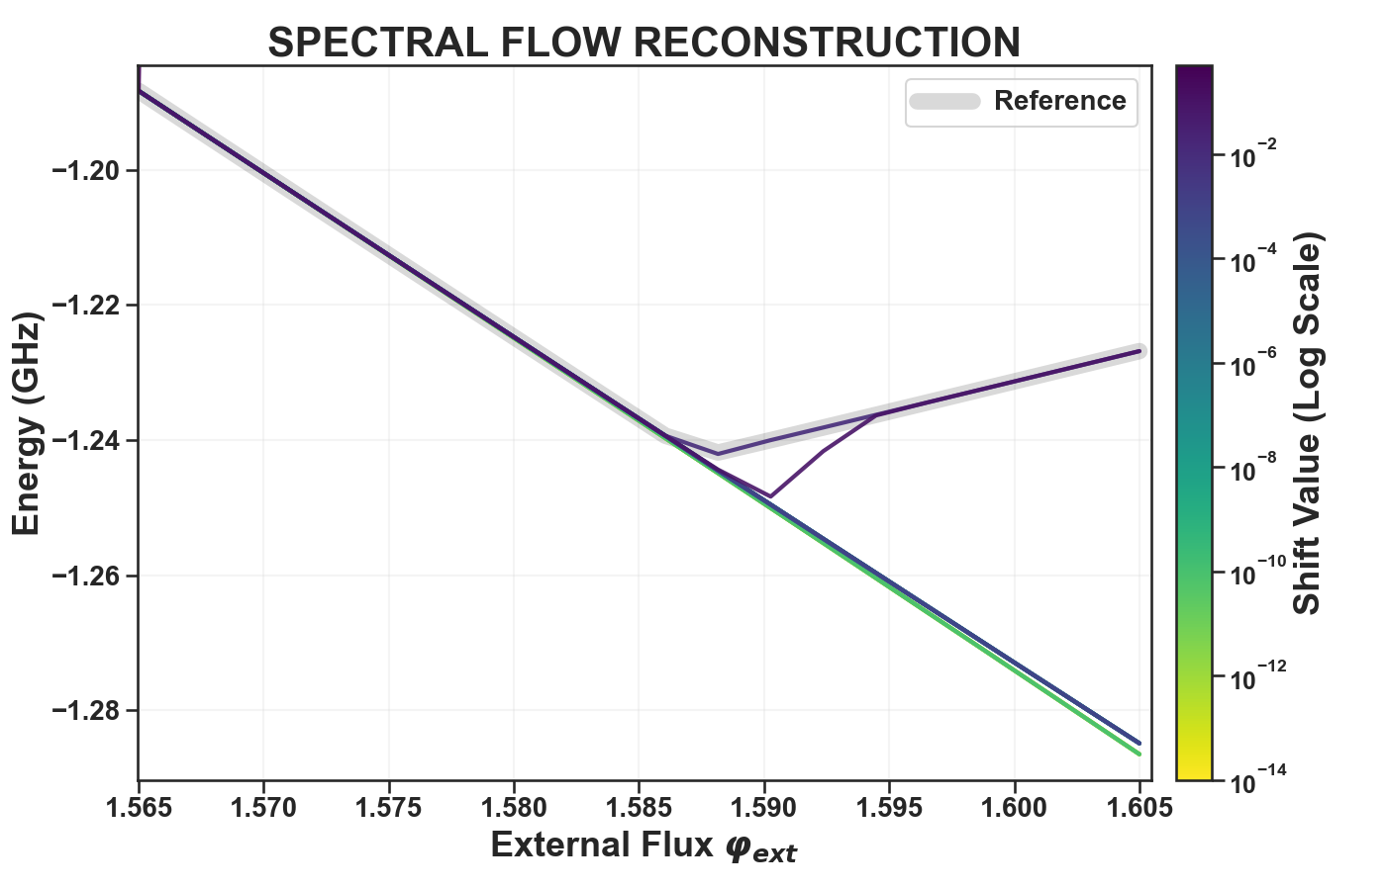
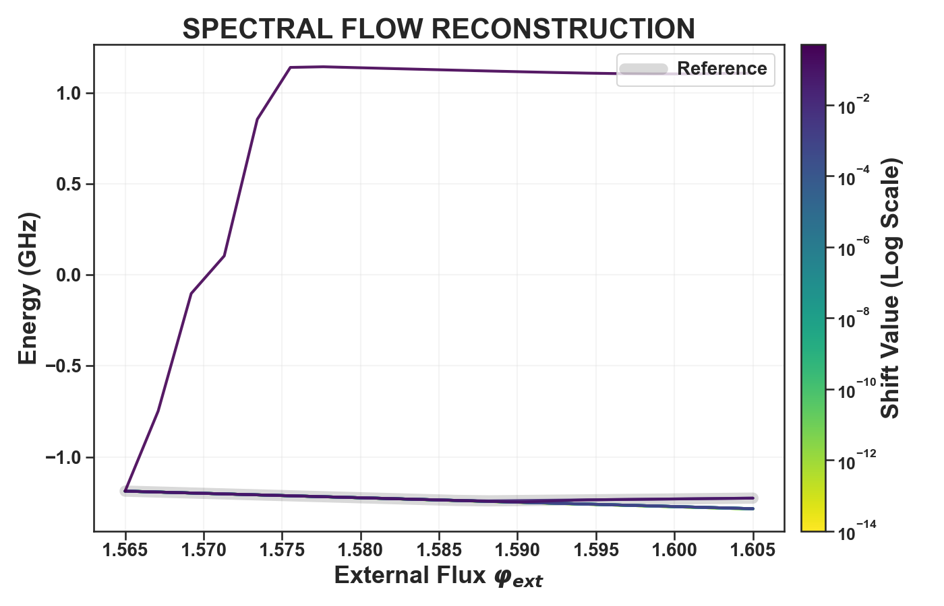
Follow trajectory, shift benchmark

Slide 21
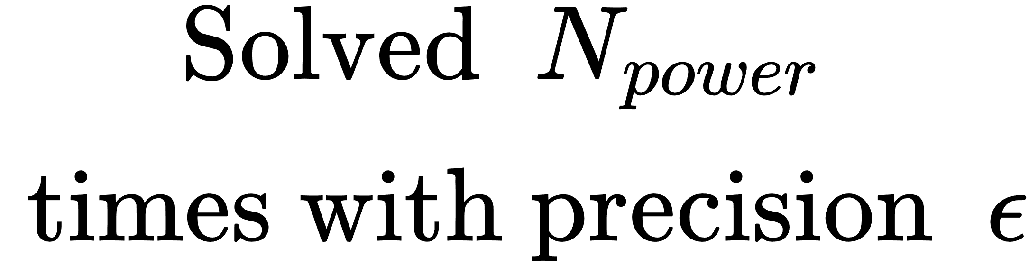
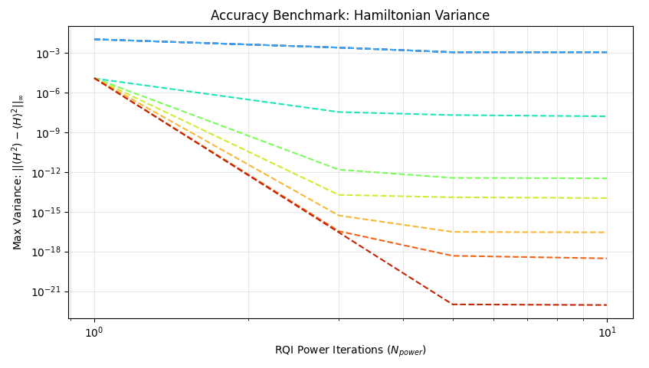
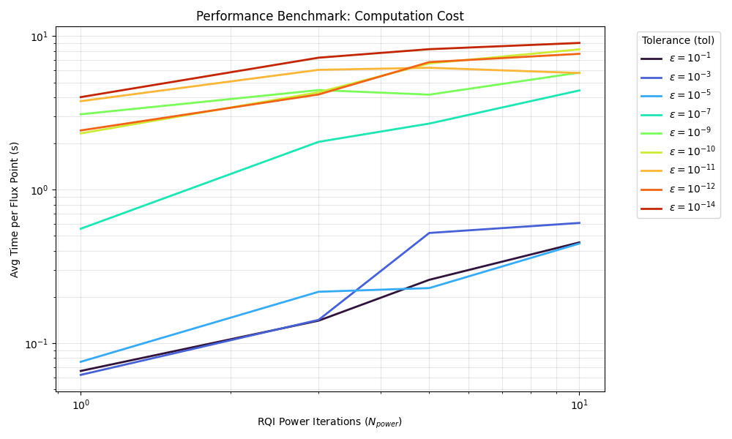
…

Slide 22
Schémas

Slide 23
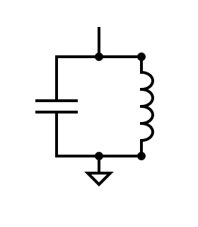
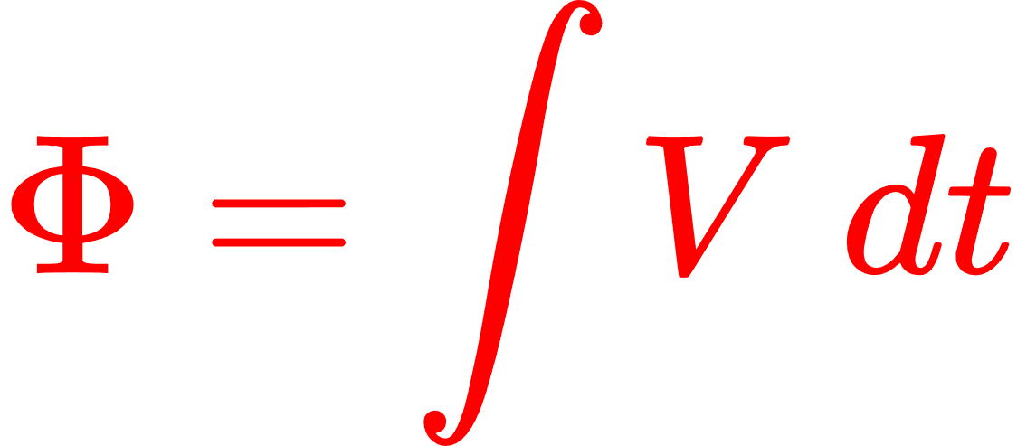
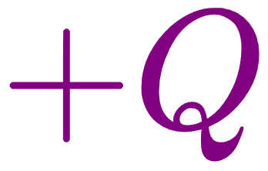

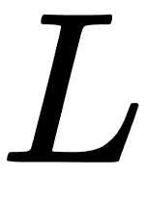
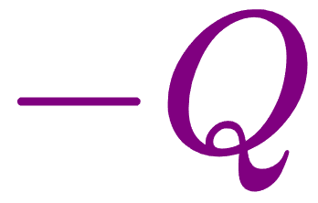

Slide 25
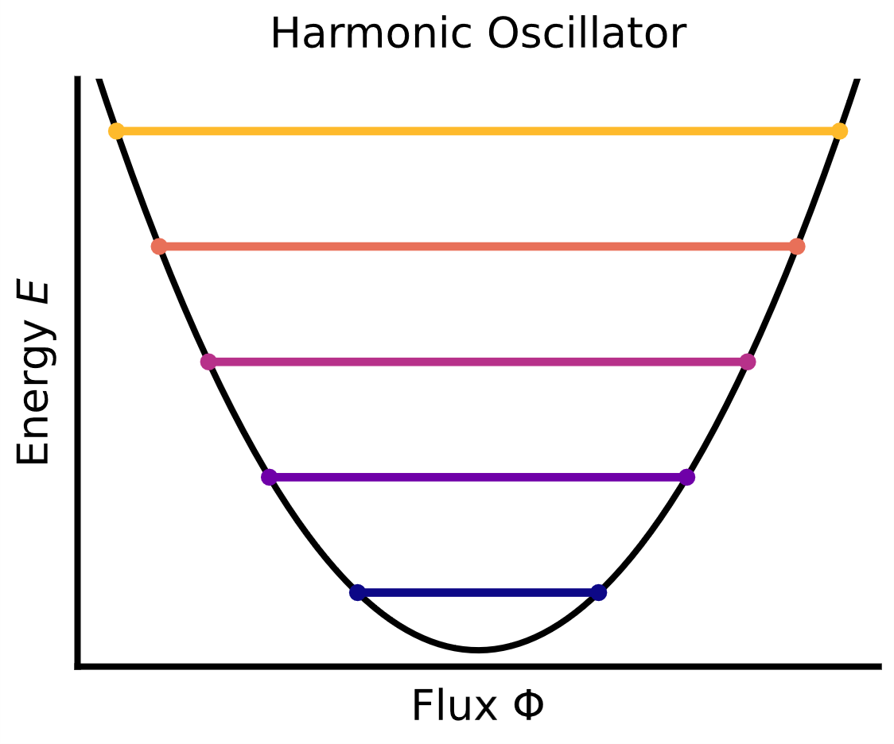


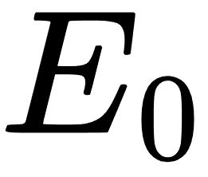

Slide 26
